Slide 1
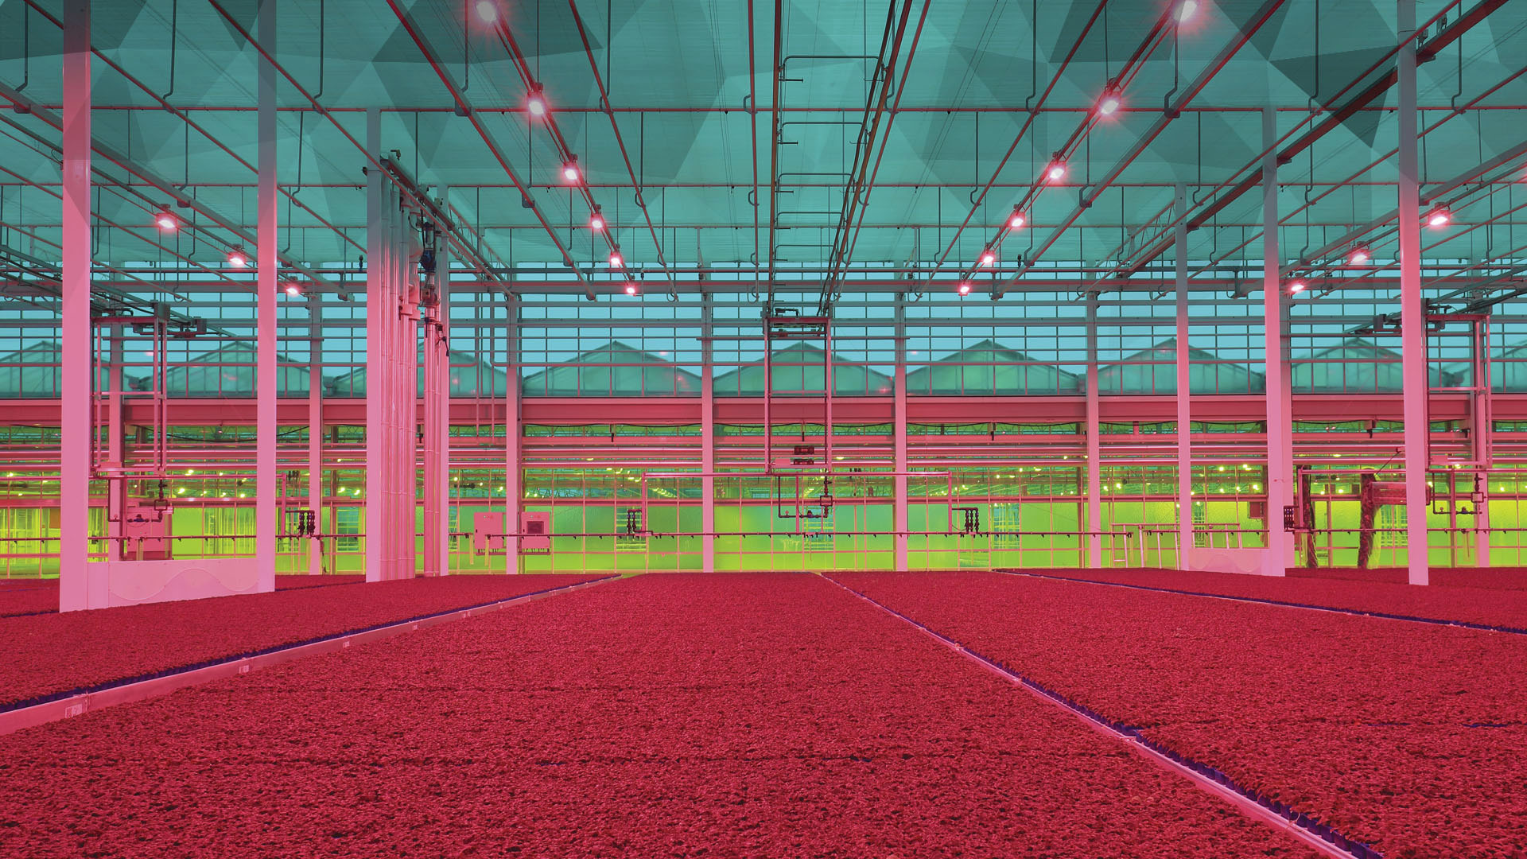
Architecture Aromatique
Notes:
Koppert – Cress Architecture Aromatique
Koppert Cress’ “Architecture Aromatique” translating to the structure and aromas of plants!

Slide 2


Notes:
Mother Nature
Shares her story with us.
Hand icon: Click on the hand icon for Julia Roberts’ Mother Nature video on YouTube.

Slide 3
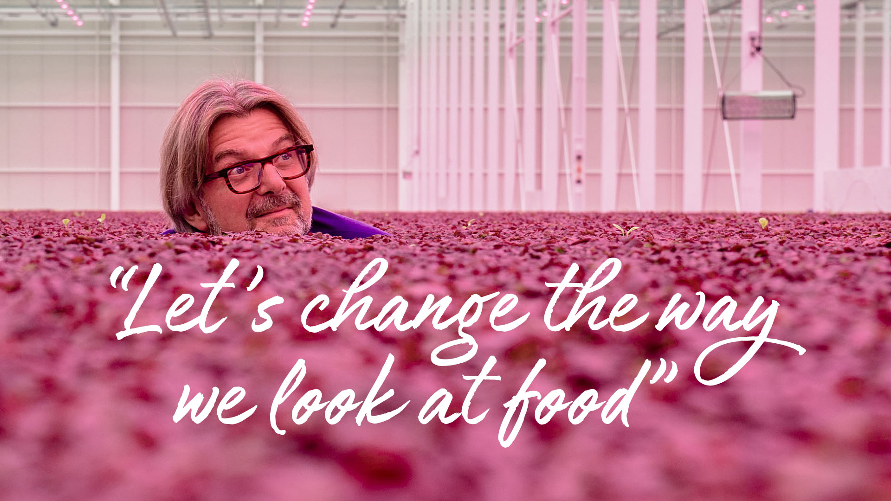
Notes:
Let’s change the way we look at food
We want to change the way people look at food and health. As with every change, it starts with ourselves. We are discovering at our own workplace how attention to food and a conscientious outlook on work can become a normal part of everyday life. Our team enjoys showing others what is possible, by using the company as a showcase, to introduce guests to new ideas and technologies. We believe in the value of dreaming big and aiming high.

Slide 4
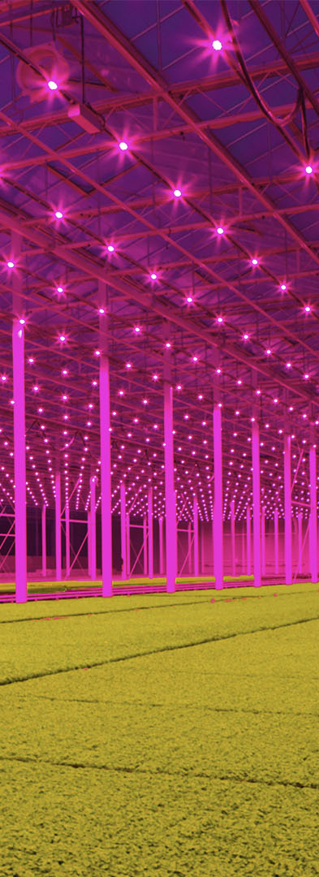
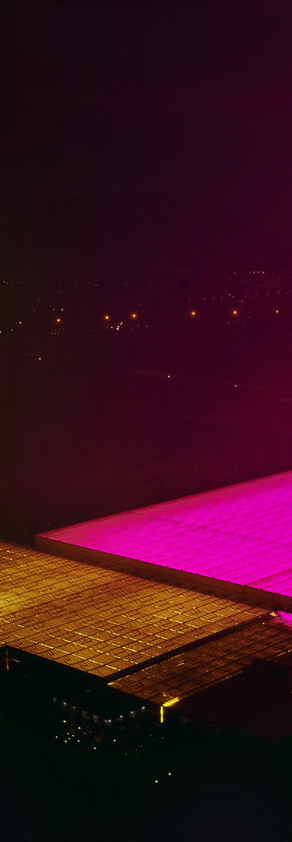
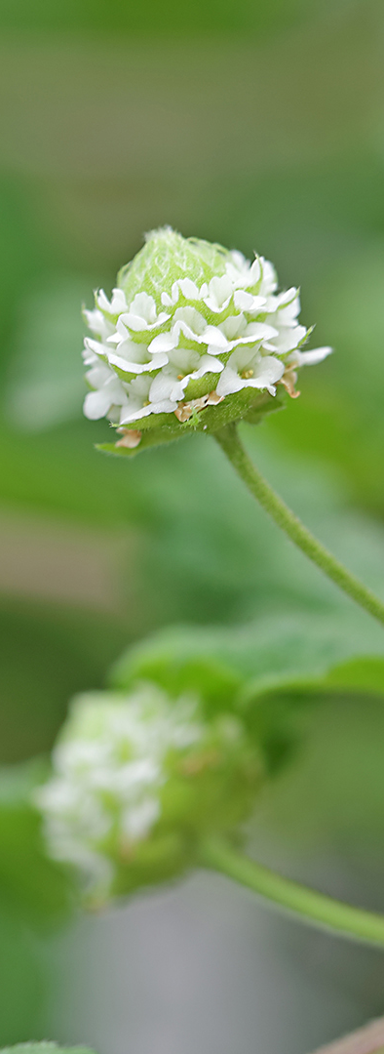
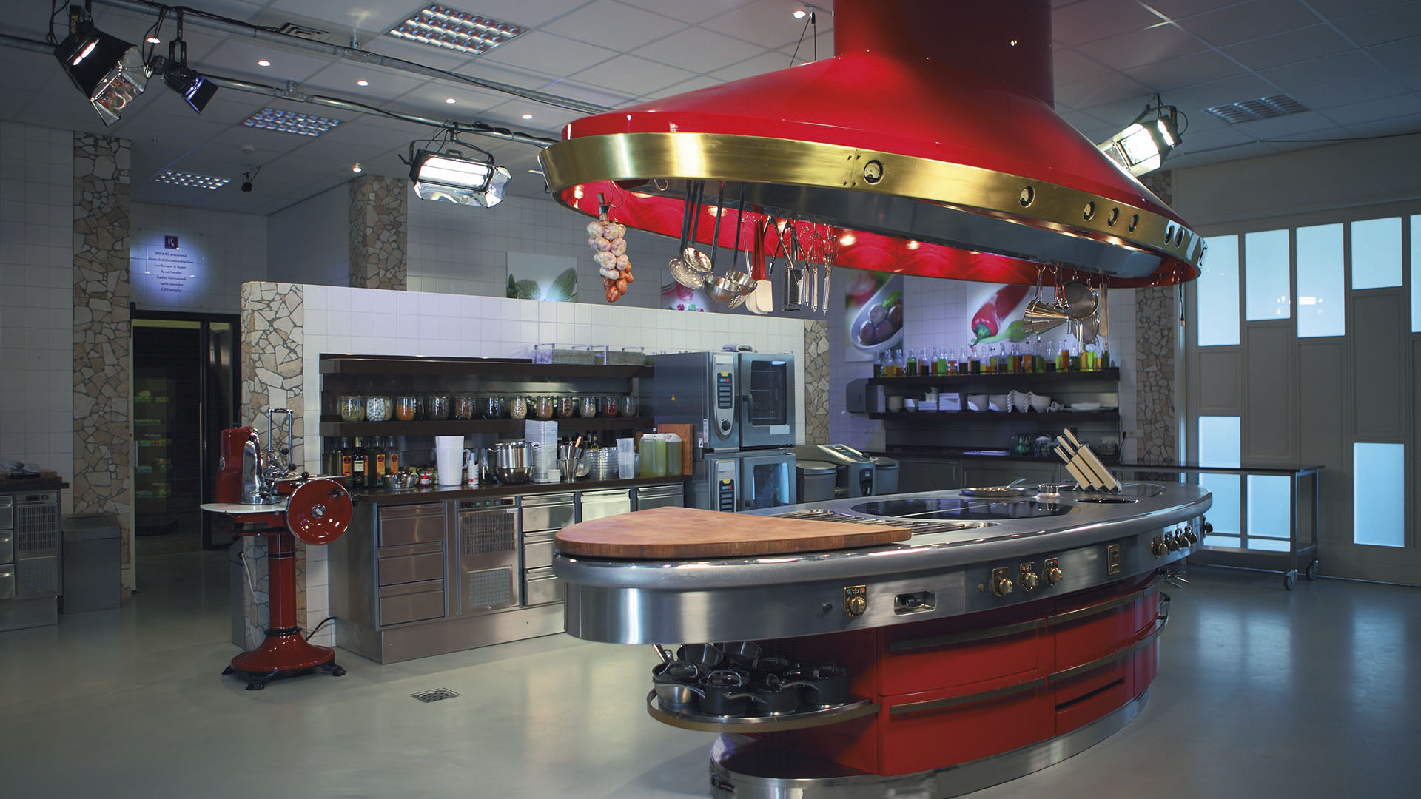
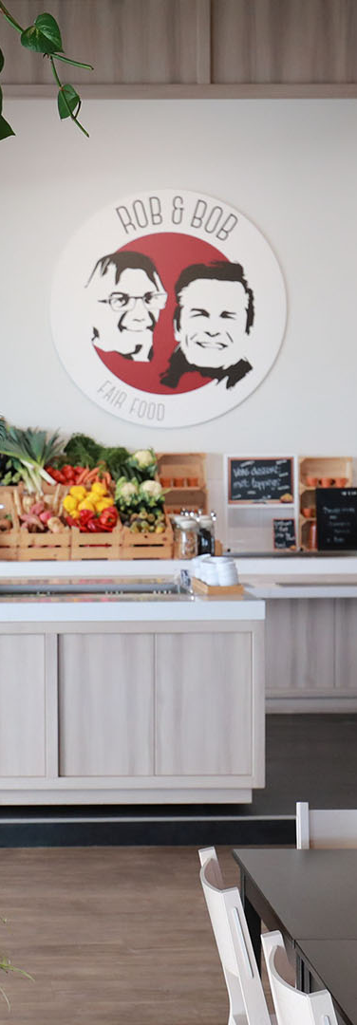
Sustainability
The why of horticulture
World
of plants
Hospitality
and
gastronomy
Food and
health
Notes:
Koppert Cress’ activities are centralized around these 5 themes
We believe these five themes are important to make a difference in, as they are all related to good, healthy food. By combining the strengths of these 5 sectors we believe we can change the way we look at food, and we can make an impact on the health of our planet and people. After the introduction, we’ll take you through these five story themes.

Slide 5
Today’s journey
Introduction to Koppert Cress
The sustainable production process
World of plants
Food and health
Gastronomy and hospitality
Notes:
Today’s journey
After a short introduction, we will share four of our five story themes: sustainability, world of plants, food and health and gastronomy and hospitality.

Slide 6
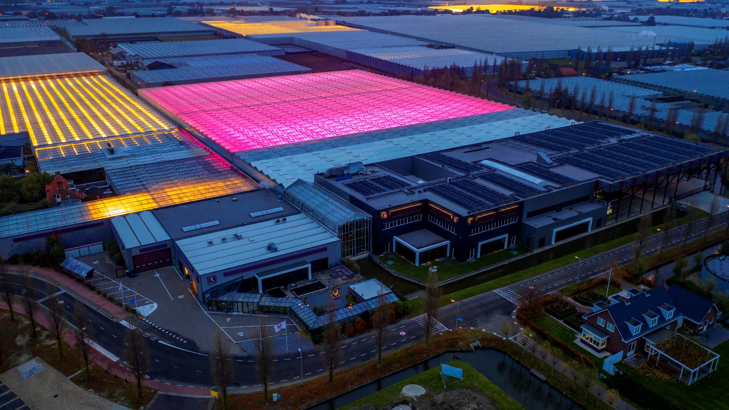
Koppert Cress
Notes:
Koppert Cress
We want to be a leader in the horticultural sector. However, our success is entirely dependent on its recognition and acceptance by the professional user. We are always on the lookout for natural, innovative ingredients which chefs can use to intensify the flavour, aroma, or presentation of their dishes; products that meet the increasingly stringent requirements of restaurants worldwide. Cresses are freshly-sprouted seedlings from 100% natural aromatic plants. They offer a freshness and intensity of taste and aroma that is only found in young seedlings. Flavour is the top priority in this regard, but there's more to it than just taste, which we’ll go into in more detail later.
Koppert Cress is based in the Westland area in the Netherlands, and currently consists of 4 different production locations, operated by around 250 colleagues.

Slide 7

Meet Rob Baan
Lives in Enkhuizen
CEO since 2002
Passion for nature, traveling and cooking
Wants to make the Netherlands the healthiest delta in the world
Notes:
Meet Rob Baan
The CEO of Koppert Cress is Rob Baan. A passionate, and sometimes stubborn man, which are traits needed to pursue his dream of making the Netherlands the healthiest country in the world. Rob is raised in Enkhuizen, known as one of the major harbour cities during the time of the Dutch East India Company in the 17th century. These endeavors put the Netherlands on the map as international traders in, amongst others, herbs and spices. Rob learned from his father to love nature from a young age. Throughout his career, he has had the opportunity to stay in many countries all over the world. All the knowledge he’s gathered during his travels about vegetables and human health encouraged him to take over a greenhouse from a radish grower and start catering to the needs of the gastronomy in 2002. This was Rob’s way to change how we look at food: by inspiring the top gastronomy about vegetables, and teaching whoever wants to listen about living the healthiest life we can.

Slide 8
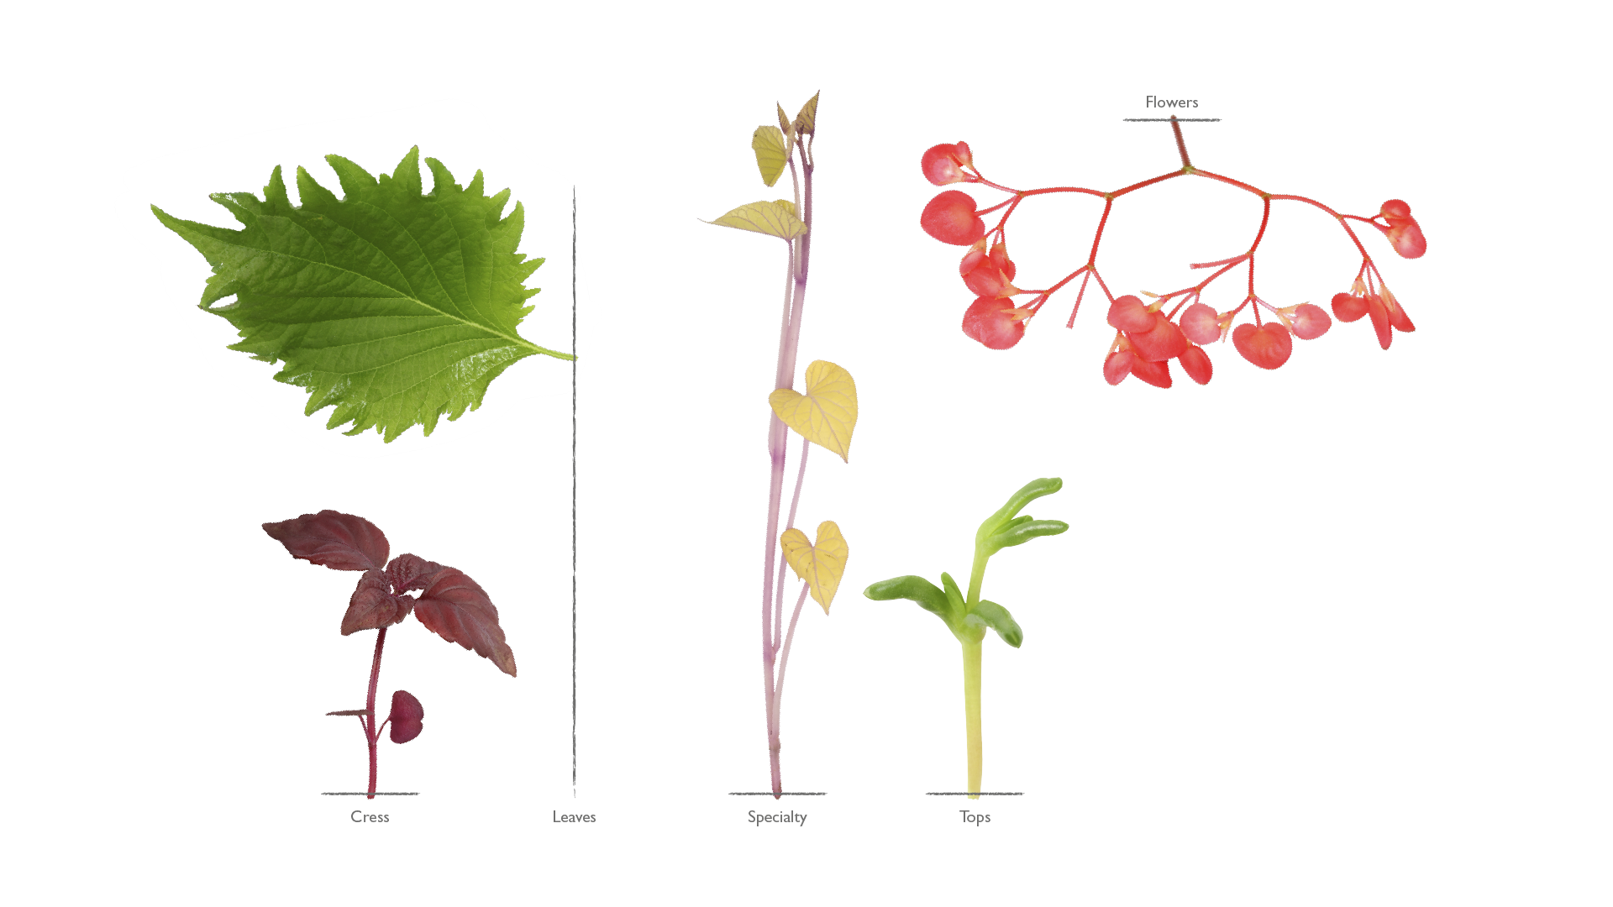
Notes:
The assortment
Our assortment currently consists of 5 types of products: Cress (e.g. Shiso Purple), Leaves (e.g. Shiso Leaves Green), Specialties (e.g. Sweet Peeper), Tops (e.g. Salty Fingers) and Flowers (e.g. Apple Blossom). Koppert Cress go plant hunting in foreign countries in order to expand their assortment.
The payoff is “Architecture Aromatique”, meaning that the products need to have structure, aroma and decorative, but should also add ‘the taste value’ to the dish when used as an ingredient or element to the plate. As you progress through the upcoming modules you will learn some of the plants will be suitable for dehydrations, powders, pulps, vinegars, emulsions, syrups, sugars and osmosis. These insights enable the best chefs to be the best.

Slide 9
Sustainability
The why of horticulture
World
of plants
Hospitality
and
gastronomy
Food and
health
Notes:
Title slide - Sustainability

Slide 10
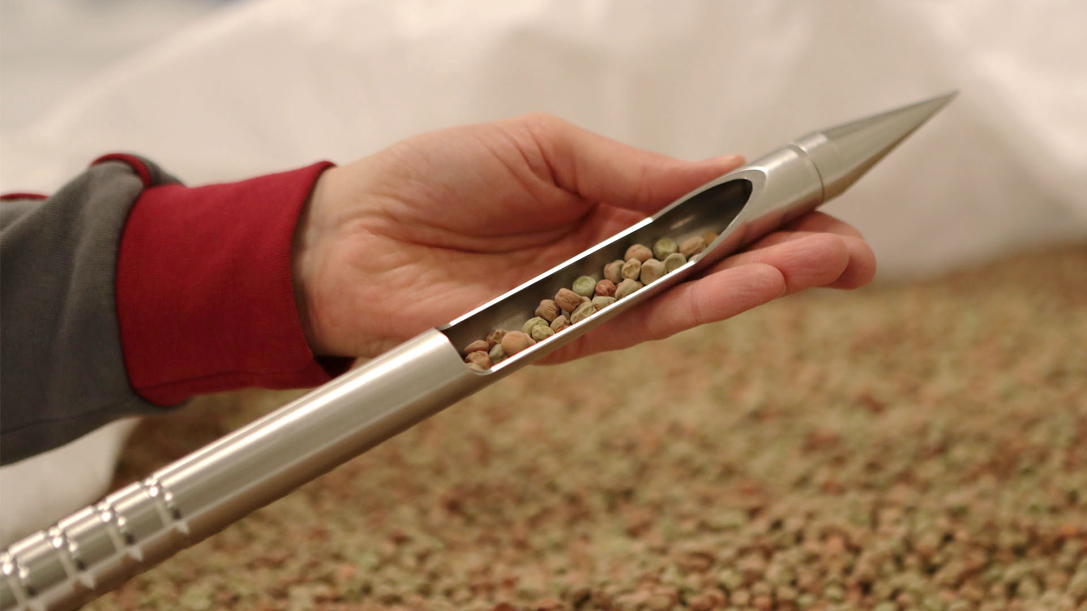
Seeds
Notes:
Seeds
It all starts with the good seeds. Food safety is a top priority for Koppert Cress. Working cleanly and safely is crucial throughout the entire process, from seed production to shipment. The ultimate purpose of the seeds – growing heirloom products for consumption – this is considered early in the production stage. In 2016 we opened the doors to our own seed supplier, called Sango Seeds. Sango Seeds’ office is located just behind the greenhouse, and provides Koppert Cress, her international license partners, and other growers all over the world with clean, good quality seeds.

Slide 11
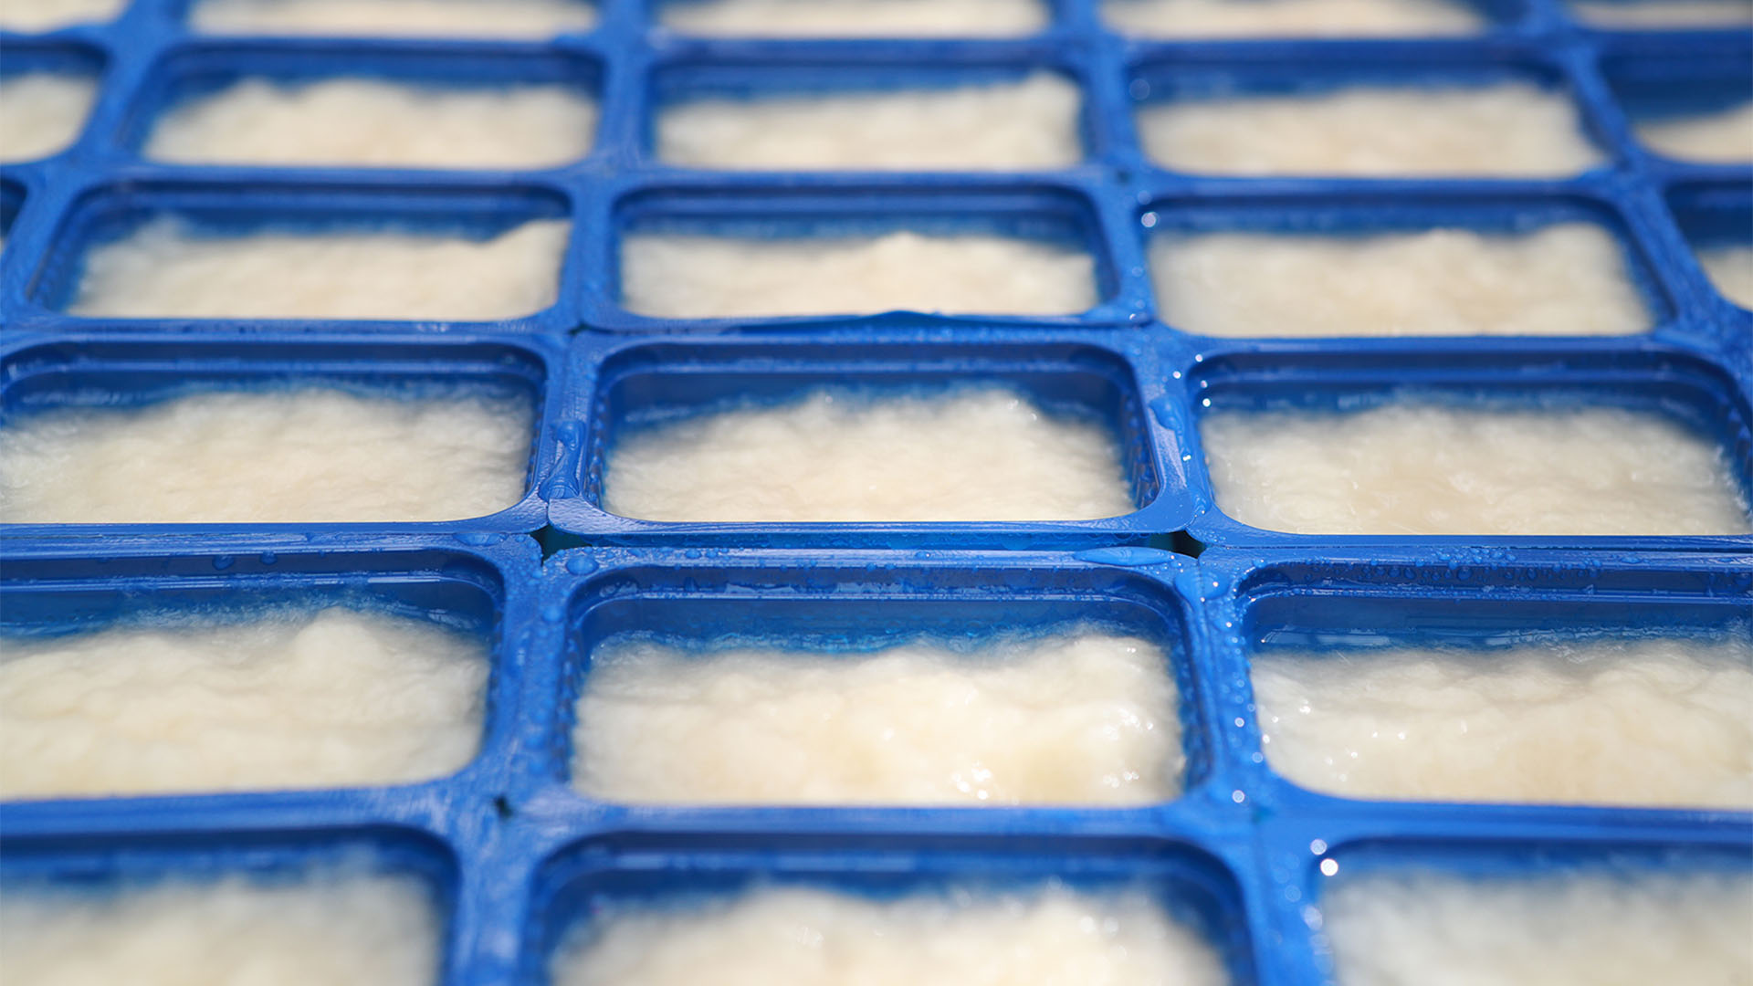
Cellulose
Notes:
Cellulose
Cellulose has been chosen as our growth medium. Wood from sustainably cultivated trees is processed into cellulose at a high temperature. This process kills all possible pathogens. By growing our cresses in cellulose instead of soil, chefs can be sure that the product is food safe to use in the kitchen. Cellulose is basically paper and used to produce (amongst others) toilet paper or diapers. Don’t worry, none of the cellulose that we use for our cress production is recycled.

Slide 12
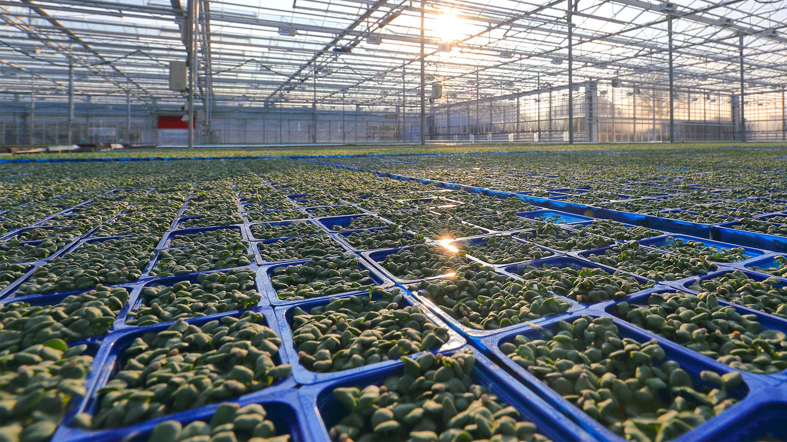
Growing process
Notes:
The growing process
Germinating seeds is not rocket science. However, it’s quite a task to be able to supply a consistent quality in large quantities. This is only possible when you master all aspects of growing. The greenhouses play an important part in this.
Climate
The process begins at the sowing line where the trays are placed on the tables, the pulp is poured into the trays and the seeds are sown by hand or machine. The tables are placed into position and covered with cloth to simulate soil. During the first few days, the cresses must be kept warm, dark, and moist to allow the seeds to germinate. Once the seeds have germinated, the cloths are removed. We maintain optimum conditions by regulating light, temperature, water and music until the crops have grown large enough for sale.

Slide 13
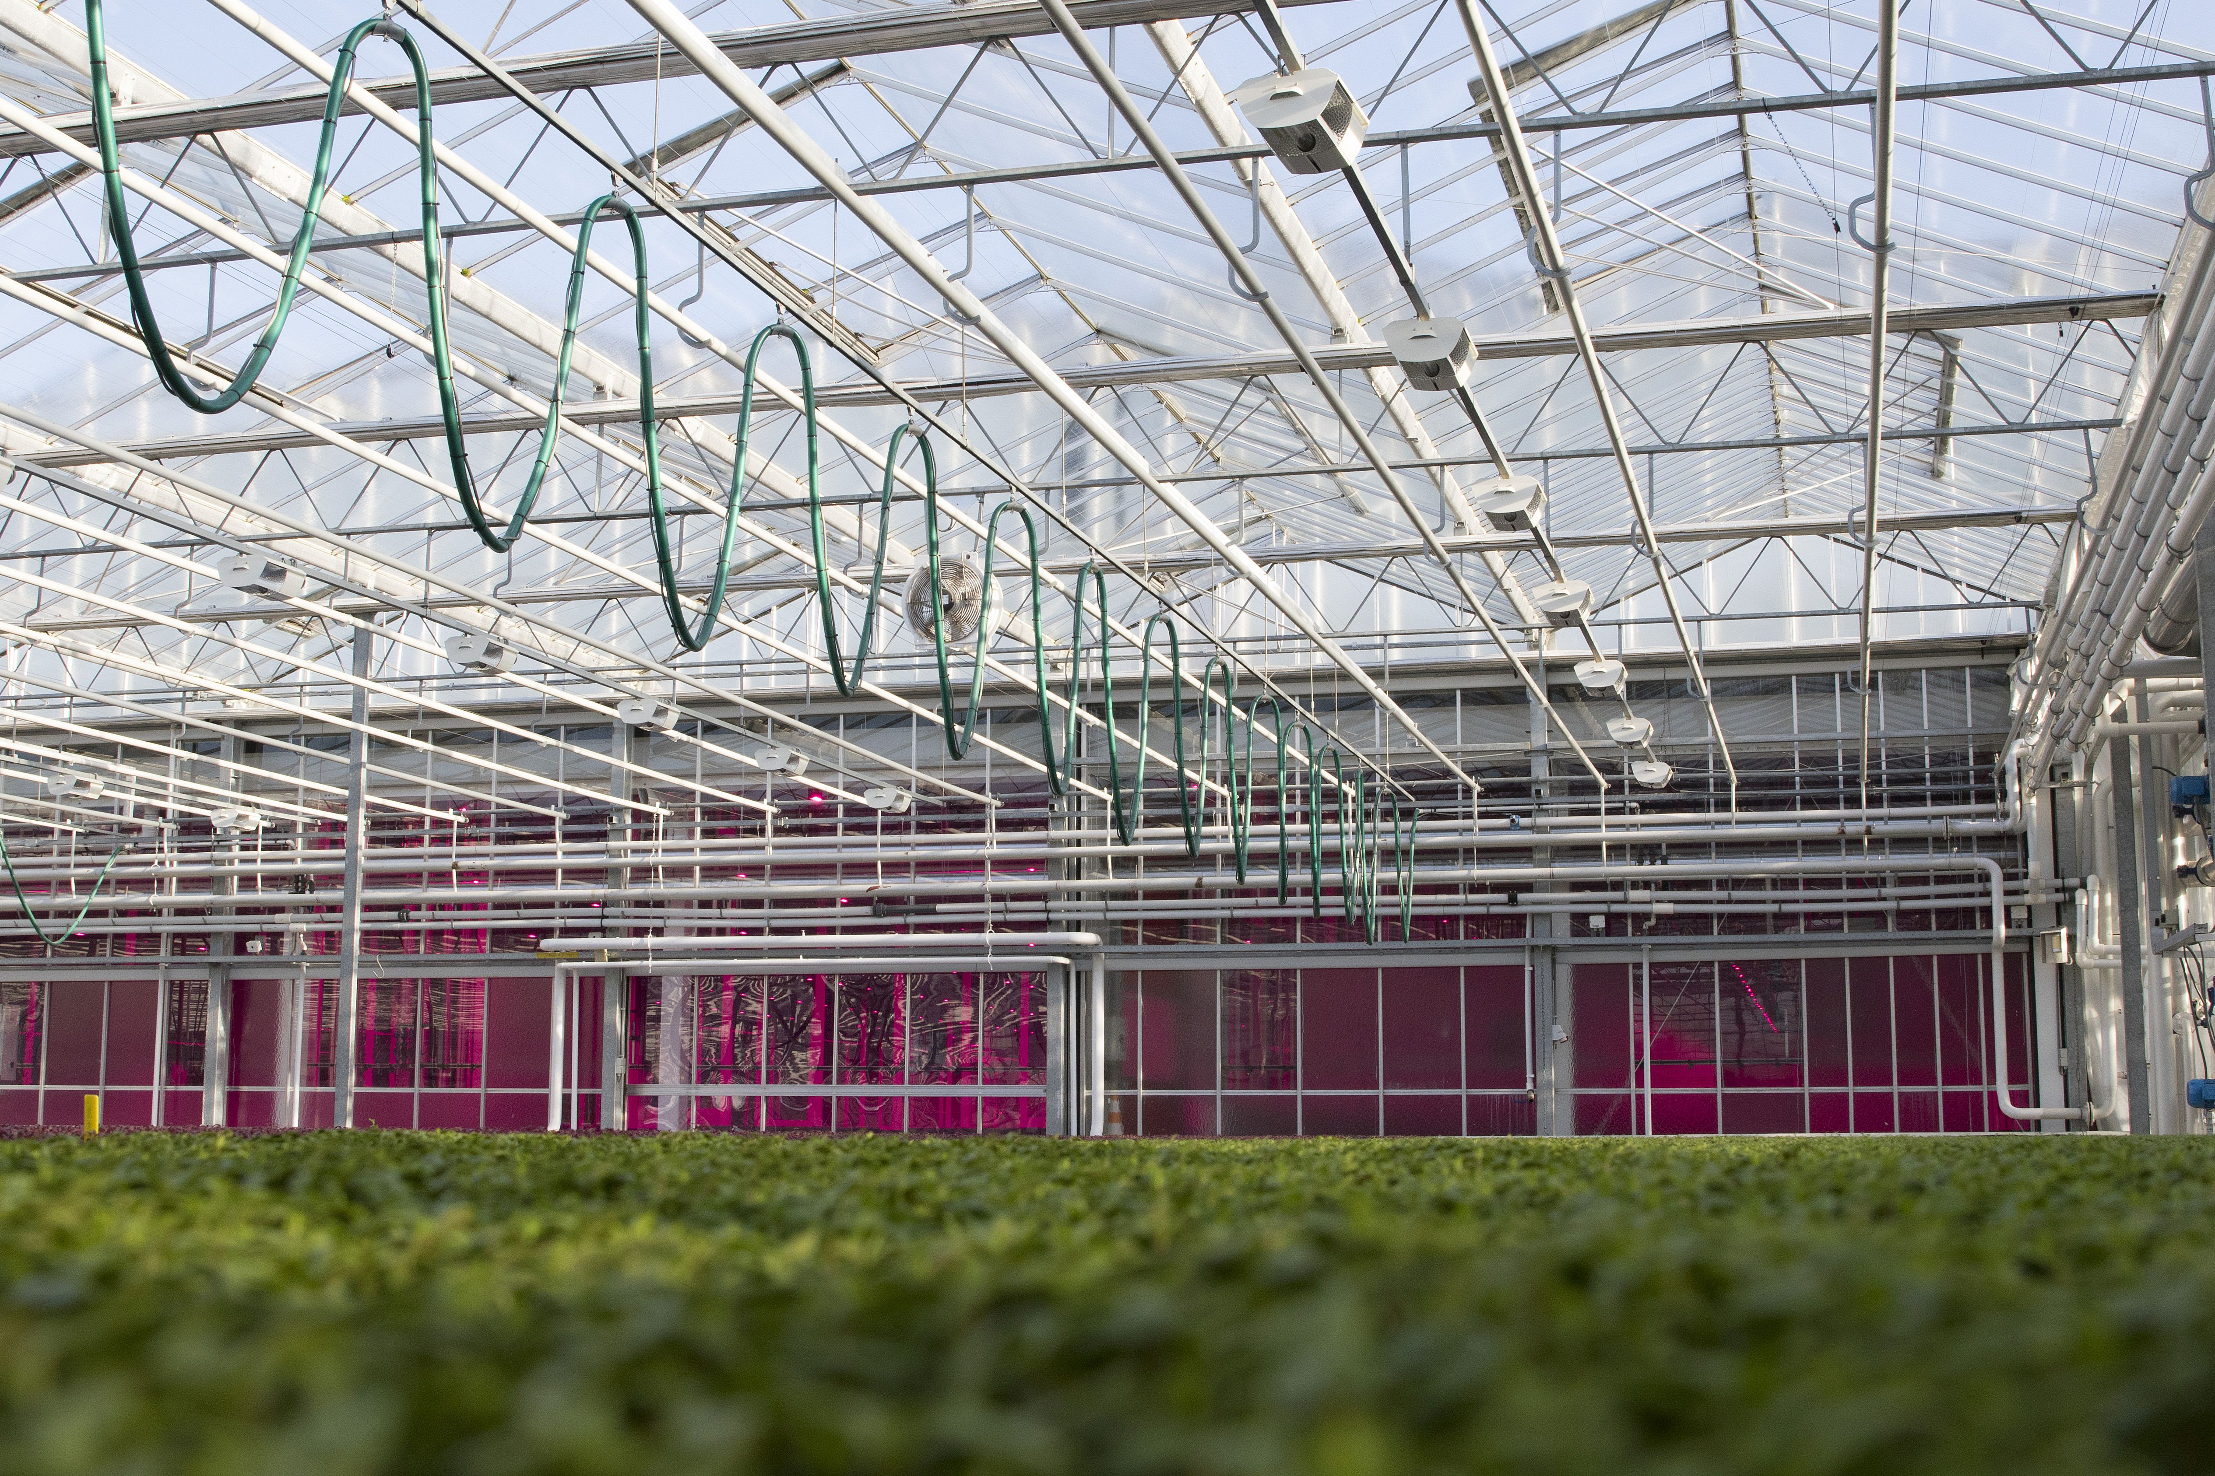
Notes:
Sustainable growing
Our continuous goal is to produce as sustainable as we can, meaning: using as little fossil fuels as possible. For this reason, we have implemented a sustainable and integrated energy system at the greenhouse attached to our greenhouses. This means that all energy sources in our company (systems that produce heat or cold) are connected to each other for optimal efficiency.
The result: our acreage may have been quadrupled through the years, but the use of gas has gone way down. We have been able to reduce the use of gas with almost 70% per sqm. Preparations are being made to start using heat from a geothermal source in the near future, which will allow us to be completely fossil fuel free on all four of our locations in the Westland area.
Nature is our most important source of energy. All systems that we use are meant to use solar energy as effective as possible. The most important parts of this system are:
WKO (heat/cold storage located 170 meters below the surface)
Water cooled LED system
Aquathermal installation to harvest heat from surface water around the greenhouse
Energy roof (A pipe system on the roof of our building used to heat up water with solar energy)

Slide 14
Sustainability
The why of horticulture
World
of plants
Hospitality
and
gastronomy
Food and
health
Notes:
Title slide – The world of plants

Slide 15

Notes:
The world of plants – Planthunting
Our inspiration comes from plants. We travel around the world with local guides who show us the 300.000 plants that grow on this earth. Can you imagine how many plant varieties you and I have never heard of before? Aside from the things you eat daily, such as carrots, beans or maybe a Dragon Fruit now and then, there are ample plants we have yet to experience. In the jungle garden at Koppert Cress we grow a selection of plants to be tasted by our guests.
The seeds that we use are brought to the Netherlands from all over the world. In an old vegetable garden high in the Andes in Peru, Rob found a plant that tastes like orange peel. In Japan he discovered leaves that tasted like garlic.
Once the genetics arrive in the Netherlands, we develops them further. Once they are cleared for consumption, our seed division Sango Seeds will propagate them for worldwide distribution.

Slide 16
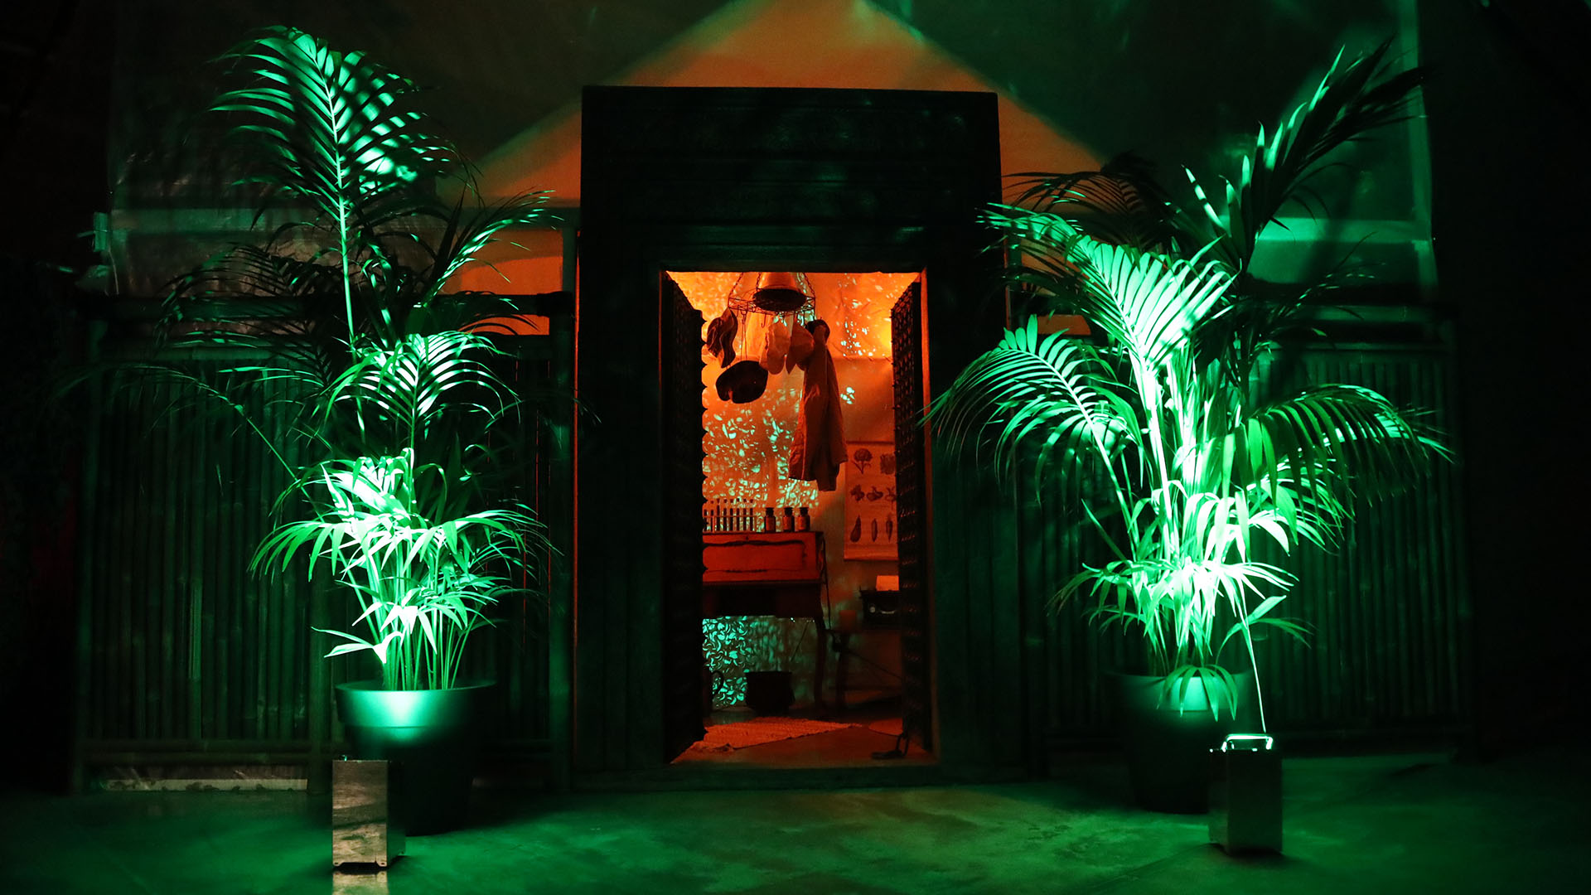
Notes:
Jungle garden
Plants are our biggest source of inspiration! To demonstrate this, We invite visitors to our jungle garden where you can taste the products straight from the mother plant, and where you can experiment with possible new additions that have been added to the range.
The garden features plants from locations around the world that give an impression of what the plant world has to offer. We like to look at plants from a different perspective, in order to discover new ways of using them for flavour and for health.
Chefs, too, are ready to be inspired by nature. They really enjoy seeing which plants grow in faraway places, or simply from your back garden or along the side of the road. The chef or bartender will then transform them into beautiful, delicious and healthy dishes in their own unique way.
Whenever we accompany chefs through the garden, they tell us about developments in the culinary world; what products are popular; and what they are looking for. This gives us insight into food trends, while the chefs and mixologists become more aware about the availability and the value of plants.
One of the latest trends is foraging, which, quite simply, means picking plants and fruits in the wild. You may have picked blackberries or herbs yourself before. That said, there's a downside to foraging: not only can it disrupt animals' habitats but excess foraging may lead to the disappearance of certain plants. This has a negative effect on biodiversity and ecological balance.
That's why it's also our responsibility to deal with this in a sustainable manner. Sustainability also means enjoying the diversity of plants that this world has to offer, without causing harm to the environment.

Slide 17
Sustainability
The why of horticulture
World
of plants
Hospitality
and
gastronomy
Food and
health
Notes:
Title slide: Food and health

Slide 18

Let food be thy medicine,
and thy medicine be thy food
Notes:
Let food be thy medicine
Using food as a way to restore your body is not new. Hippocrates have already said this in time: “Let food be thy medicine, and thy medicine be thy food.”

Slide 19
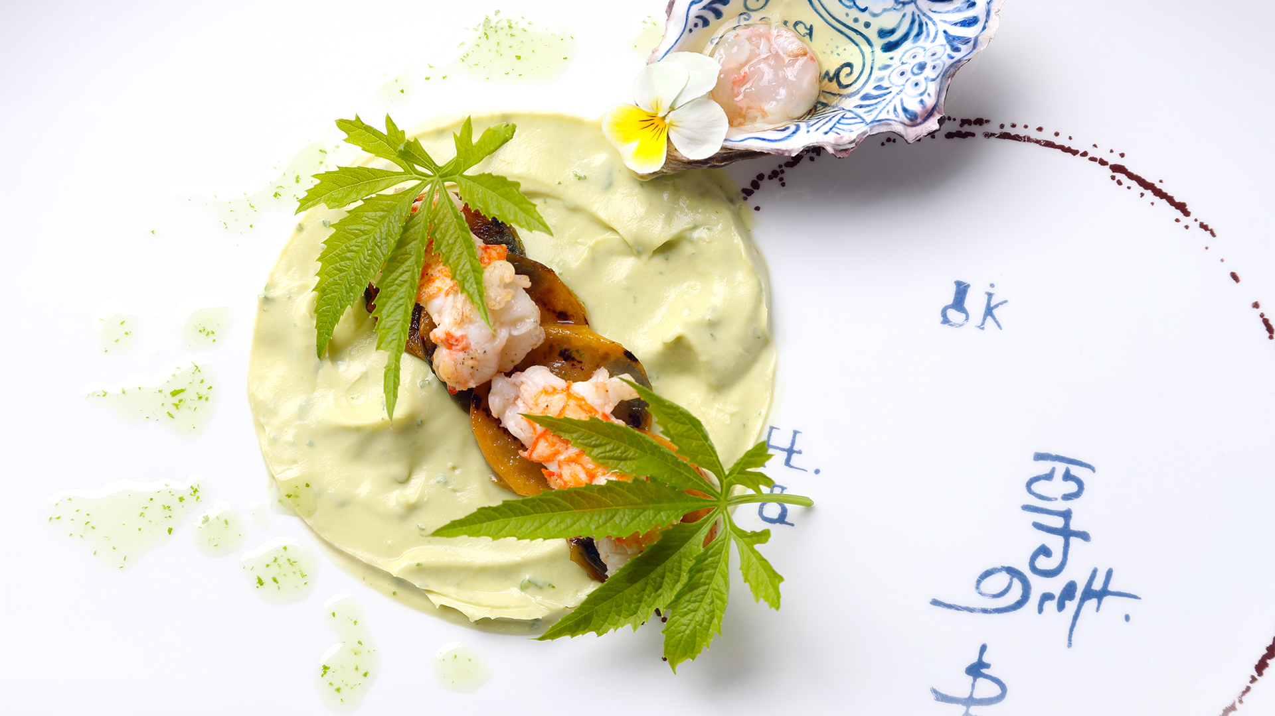
Our vision on food and health:
We strongly believe good food is crucial for a healthy existence.
Notes:
Vision on “Food and health”
We strongly believe that good food is crucial for a healthy existence.

Slide 20

Notes:
The human diet
Imagine you are sent into the woods, without clothes or weapons. What would you eat? If you’re lucky, you might catch a rabbit or a fish, but you’ll mainly survive eating plants. Ever since humans have existed our bodies and digestive systems have been focused on a diet of plants. We need to eat plants to stay healthy. Throughout all those years our bodies never changed, but we did change our eating habits. The last 100 years we have drastically changed the way we eat. Processed foods, with unnatural amounts of salt and sugar, lacking the nutrients that we need to stay in optimal health. Our point is, let’s start eating again what our bodies are made for.

Slide 21
[res·tau·rant (rst-ränt, -tr-nt)n. from present participle of restaurer, to restore, from Old French restorer;
see restore: to bring back to or put back into a former or original state (Medical Definition of restore)]
Notes:
The meaning of the word “restaurant”
Little people know that the word “restaurant” comes from the French “restaurer” or ‘to recover’. It is derived from the Latin restaurare: remake, rebuild and renew.
In 1765 a french chef, A. Boulanger, opened a diner in Paris where several soups were prepared from which the guest could choose. These soups were called “soup restaurante”: a restorative soup with a lot of vegetables. From this the word “restaurant” developed into what it is today. So at that time, a restaurant was a place where people could restore their bodies by eating a lot of vegetables.

Slide 22
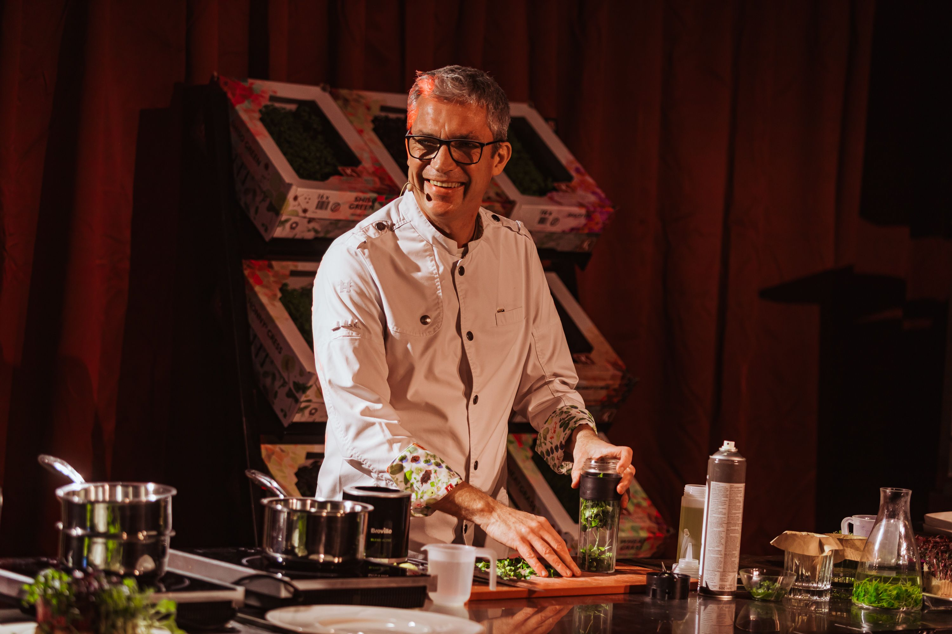
There is a reason a chef wears the same white jacket as a doctor
Notes:
The importance of a chefs jacket
Have you ever wondered why chefs jackets look similar to that of a doctor? That’s because in the past, when medicines as we know now weren't invented, chefs were doctors. Instead of medicine, they used healthy meals to boost the health of their patients, this is why the chefs job is so important, we are the medicinal doctors.

Slide 23
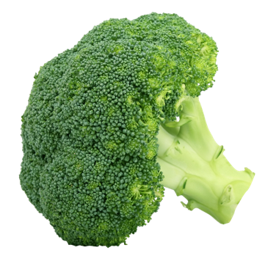
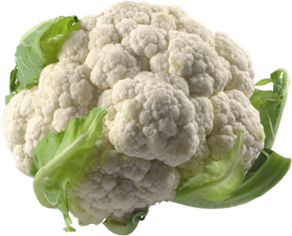
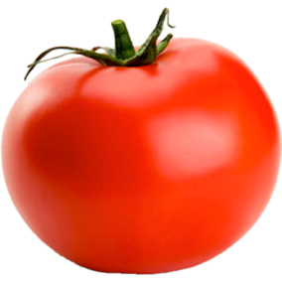
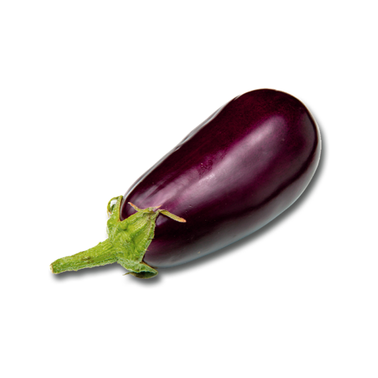
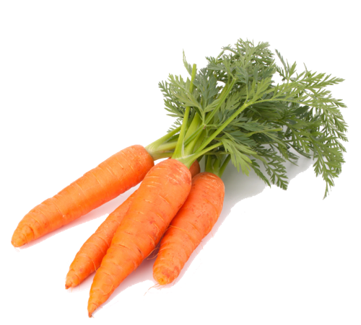
Lutein/Zeaxanthin
Isoflavones
EGCG
Isothiocynates
Sulphoraphane
Glucosinolates
EGCG
Aalicin
Quercetin
Indoles
Lycopeen
Anthocyanidins
Ellagic acid
Quercetin
Hesperidia
THE GREEN
PHARMACY
Alpha-Carotene
Beta-Carotene
Beta cryptoxanthin
Lutein/Zeaxanthin
Hesperidin
Resveratrol
Anthocyanidins
Phenolics
Flavonoids
Notes:
The green pharmacy
Vegetables contain many different nutrients that the human body needs to stay healthy. Plants are basically medicine, or a “green pharmacy”. Often we are asked what balance of fruit and vegetables people should eat. At this moment in time this is difficult to answer. It is possible to measure the nutrients in a plant (as you can see in this photo), but human bodies are so complex, that it is still impossible to describe exactly what the effects are of vegetables on your health. However, while measuring technology is progressing, the thing you can remember is: eat the rainbow. Eat different colors and different types of vegetables, and the chance of you eating a complete palette of nutrients will increase significantly.

Slide 24
Sustainability
The why of horticulture
World
of plants
Hospitality
and
gastronomy
Food and
health
Notes:
Title slide – Hospitality and gastronomy

Slide 25
Top down inspiration
Notes:
Top down inspiration
Koppert Cress build their markets by inspiring top chefs in the top of the pyramid. The layers below the top will look up for inspiration and copy their methods and ingredients. This way, by focusing on a relatively small number of end-users, Koppert Cress can inspire a larger group of end-users to use their products. We do this, because cresses, edible flowers, leaves and many other plants that they grow, are not known to the general public. People would have no idea how to use these products in their cooking. The top gastronomy therefore functions as a kind of teacher, to show the metaphorical students everything that is possible to be creative.

Slide 26
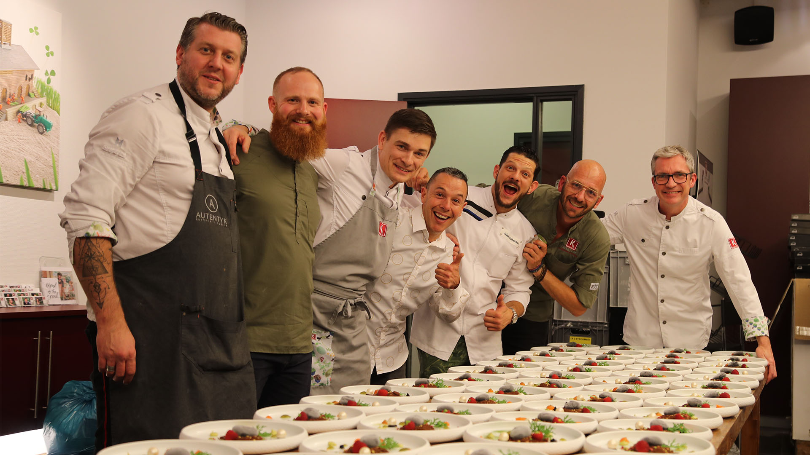
Notes:
Marketing
Our marketing team can be found on events focused on gastronomy and trade, but they also organize all kinds of events at Koppert Cress home base. Examples are cooking workshops during which chefs can try out our Molteni Podium IV (a special “Ferrari-red stove), with an additional tasting and tour through the company. In this way our guests get to know our product, our company and our dreams and in return we get to know theirs. The goal is to inspire and be inspired.

Slide 27
Koppert Cress pull strategy
Notes:
Koppert Cress pull strategy
One of the success factors for Koppert Cress has been the pull-strategy for our distributional approach. By inspiring the top gastronomy directly and asking them to order our products from their own vegetable supplier, we create a market-pull resulting in the distributional channel forming itself. This results in Koppert Cress having a relatively small number of direct customers (around 120), compared to the relatively large number of end-users (restaurants). Exactly how many restaurants we supply indirectly, is still a guess.

Slide 28
Notes:
Molteni Podium IV
We often invite guests to have a Cressperience either in our meeting rooms and demonstration kitchen or at another destination. Cressperience is an amalgamation of the words ‘cress’ and ‘experience’ and is a concept that has been created to engage our visitors through all five senses.
Around 300 groups – varying in size from two to 250 people – visit Koppert Cress each year. Visitors range from suppliers; direct buyers; chefs and catering staff to elected representatives and politicians. Cresserie is our old company restaurant that has been converted into a Mixology Training bar and meeting room.
Hand icon: Click on the hand icon for a YouTube video of a Cressperience event Koppert Cress hosted in 2019.

Slide 29
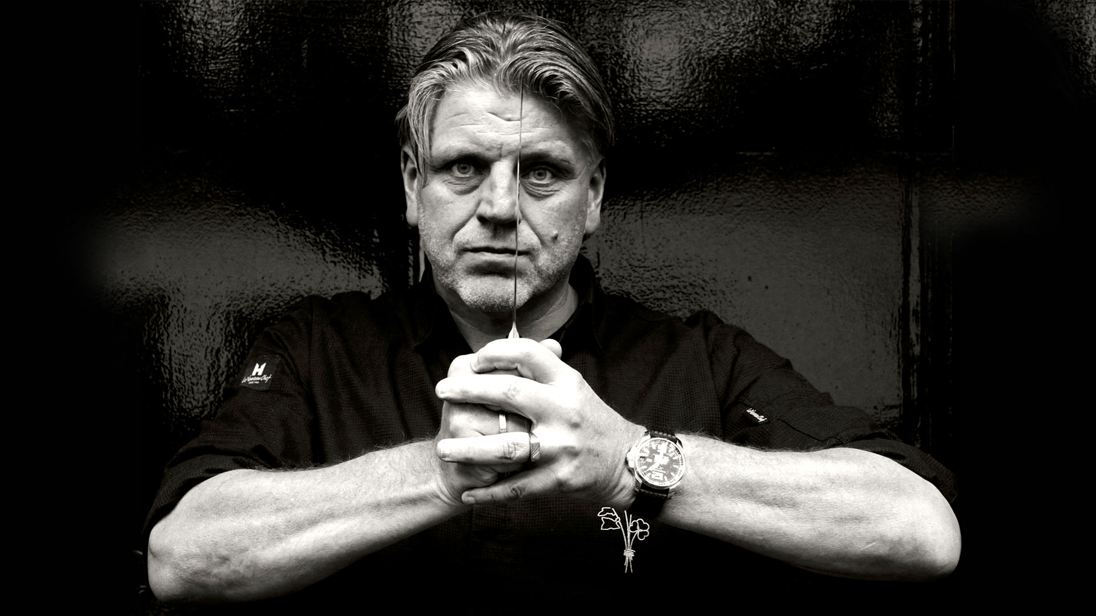

100 unique components by Librije’s Atelier on
“I am delighted to make this contribution towards Gastronomixs ambitions to create a global platform, as sharing and conserving knowledge is vital to our profession.”
Jonnie Boer
Notes:
Gastronomixs
Is an online idea generator for chefs which provides recipes in the form of building blocks that you can use to create new dishes in no time!
Jonny Boer *** Librije Zwolle Netherlands has contributed over 100 components to Gastronomixs to create a global platform for Students and Chefs to access. “Knowledge is vital to our profession”
Hand icon: Click on the hand icon for a Gastronomixs explanation video on YouTube.

Slide 30
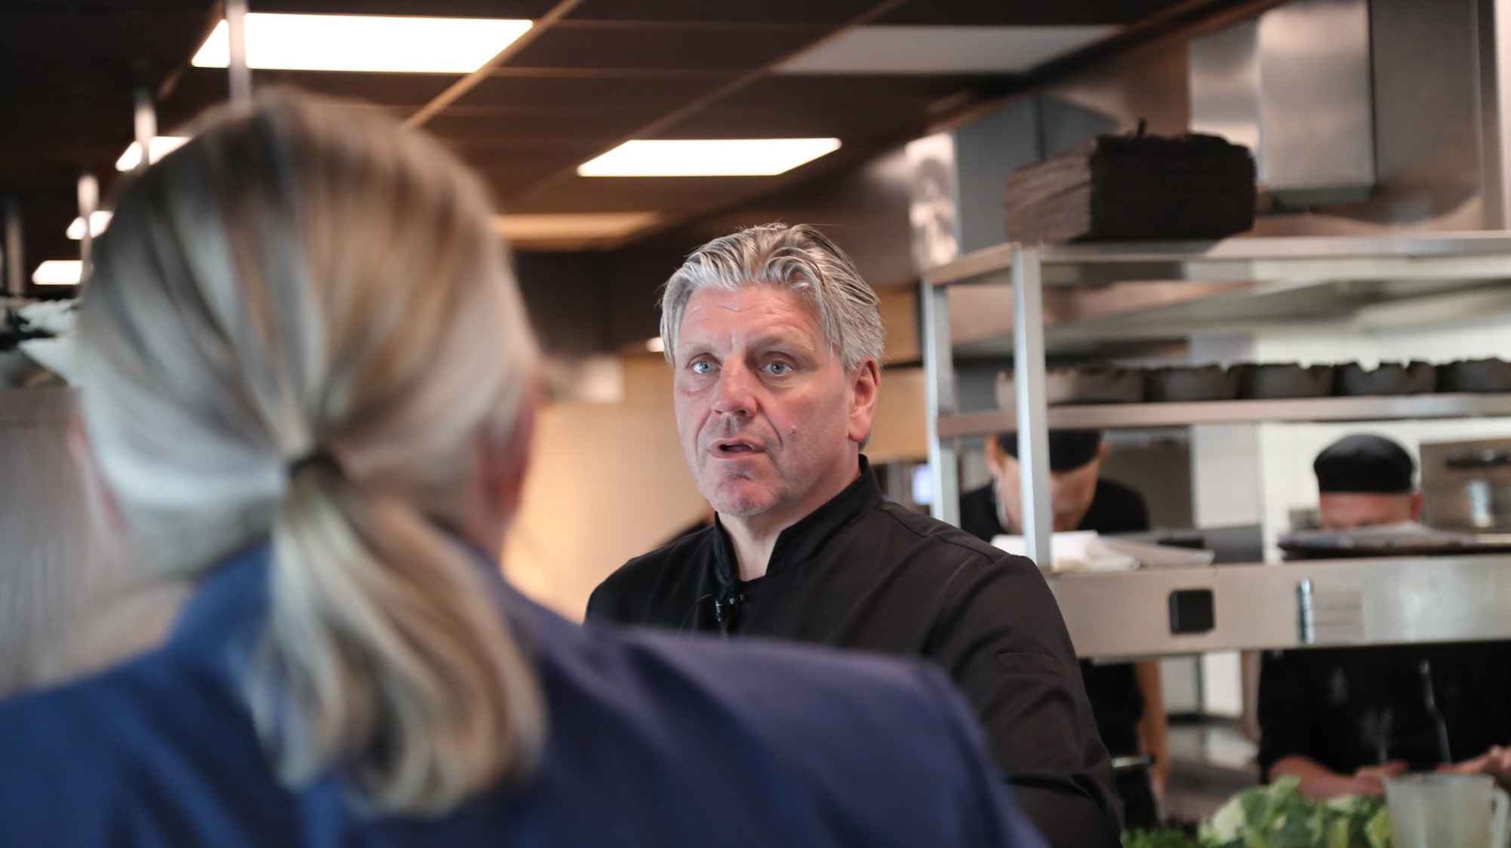
Notes:
Librije Zwolle Netherlands
Jonny Boer *** has worked with Koppert Cress for many years deconstructing and rebuilding gastronomy.

Slide 31
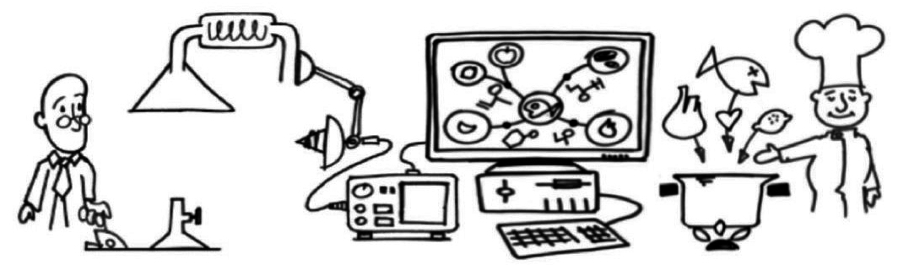
What do we do at Foodpairing®?
Process
Aroma analysis
Data processing and visualization pairings
Inspire bartenders and chefs to create
Notes:
Foodpairing
Q: Can anyone tell me what Food Pairing is?
A: It’s when different foods have the same aroma components in common.

Slide 32
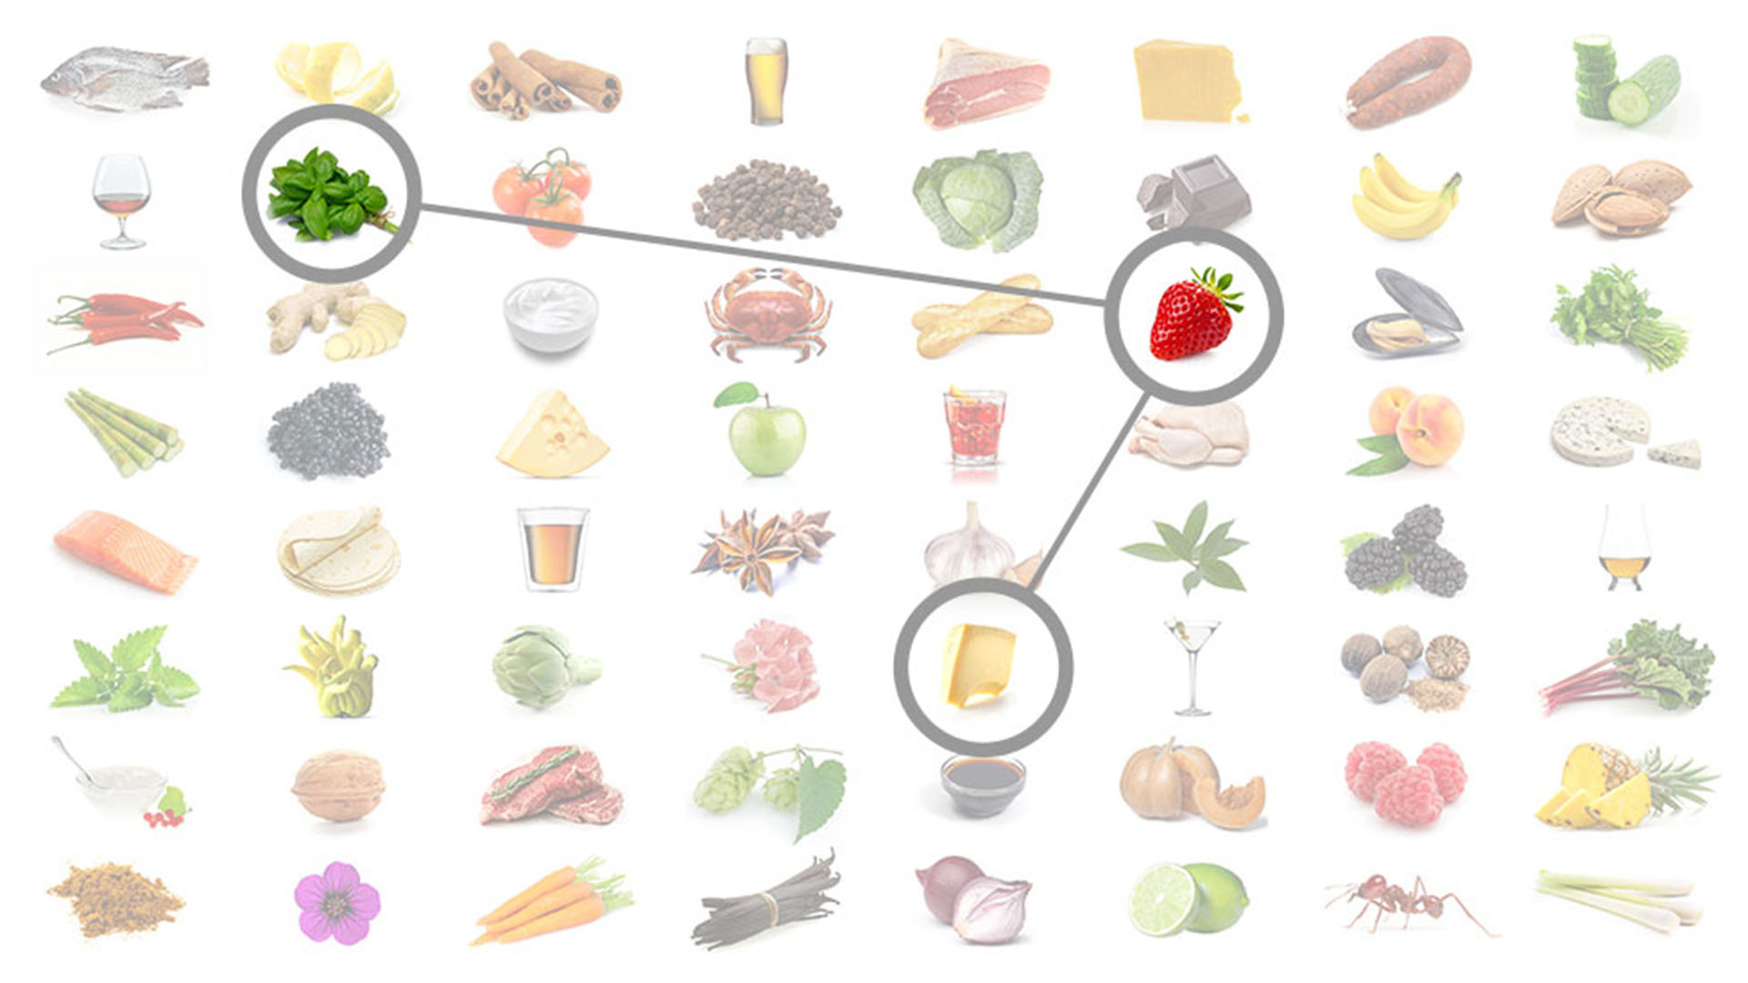
Foodpairing®
Ingredients match when they have important aroma components
in common.
Notes:
Foodpairing
Here you see a trio combination of aged Cheese, Basil Cress and Strawberries. This combination is called Food Pairing.
(Please give samples out for students to eat) Carpaccio of Strawberries with cracked pepper, drizzle of aged oil, parmesan, Rock Chives and Basil Cress.

Slide 33
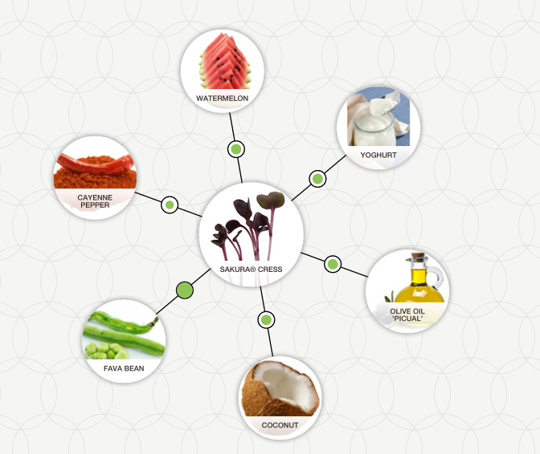
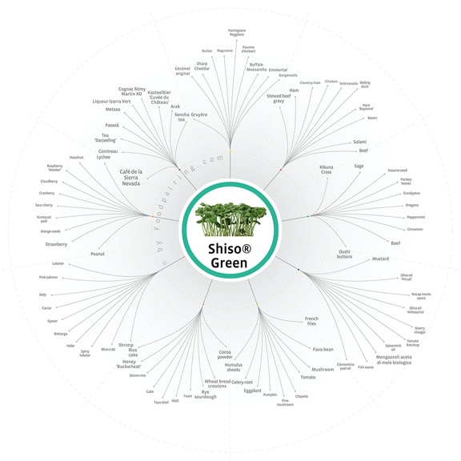

Foodpairing with Cress
Sakura Cress®
Shiso Green
Notes:
Foodpairing
Please taste the Sakura Cress! (Students to pass round) Traditionally, chefs would use this product on sushi, Asian foods and fish, as you can see the Sakura Cress pairs also well with cayenne pepper, beans, oil, coconut and even chocolate. Nutritionally, Sakura Cress has a compound high antioxidant which is found also in dark berries called anthocyanins.

Slide 34
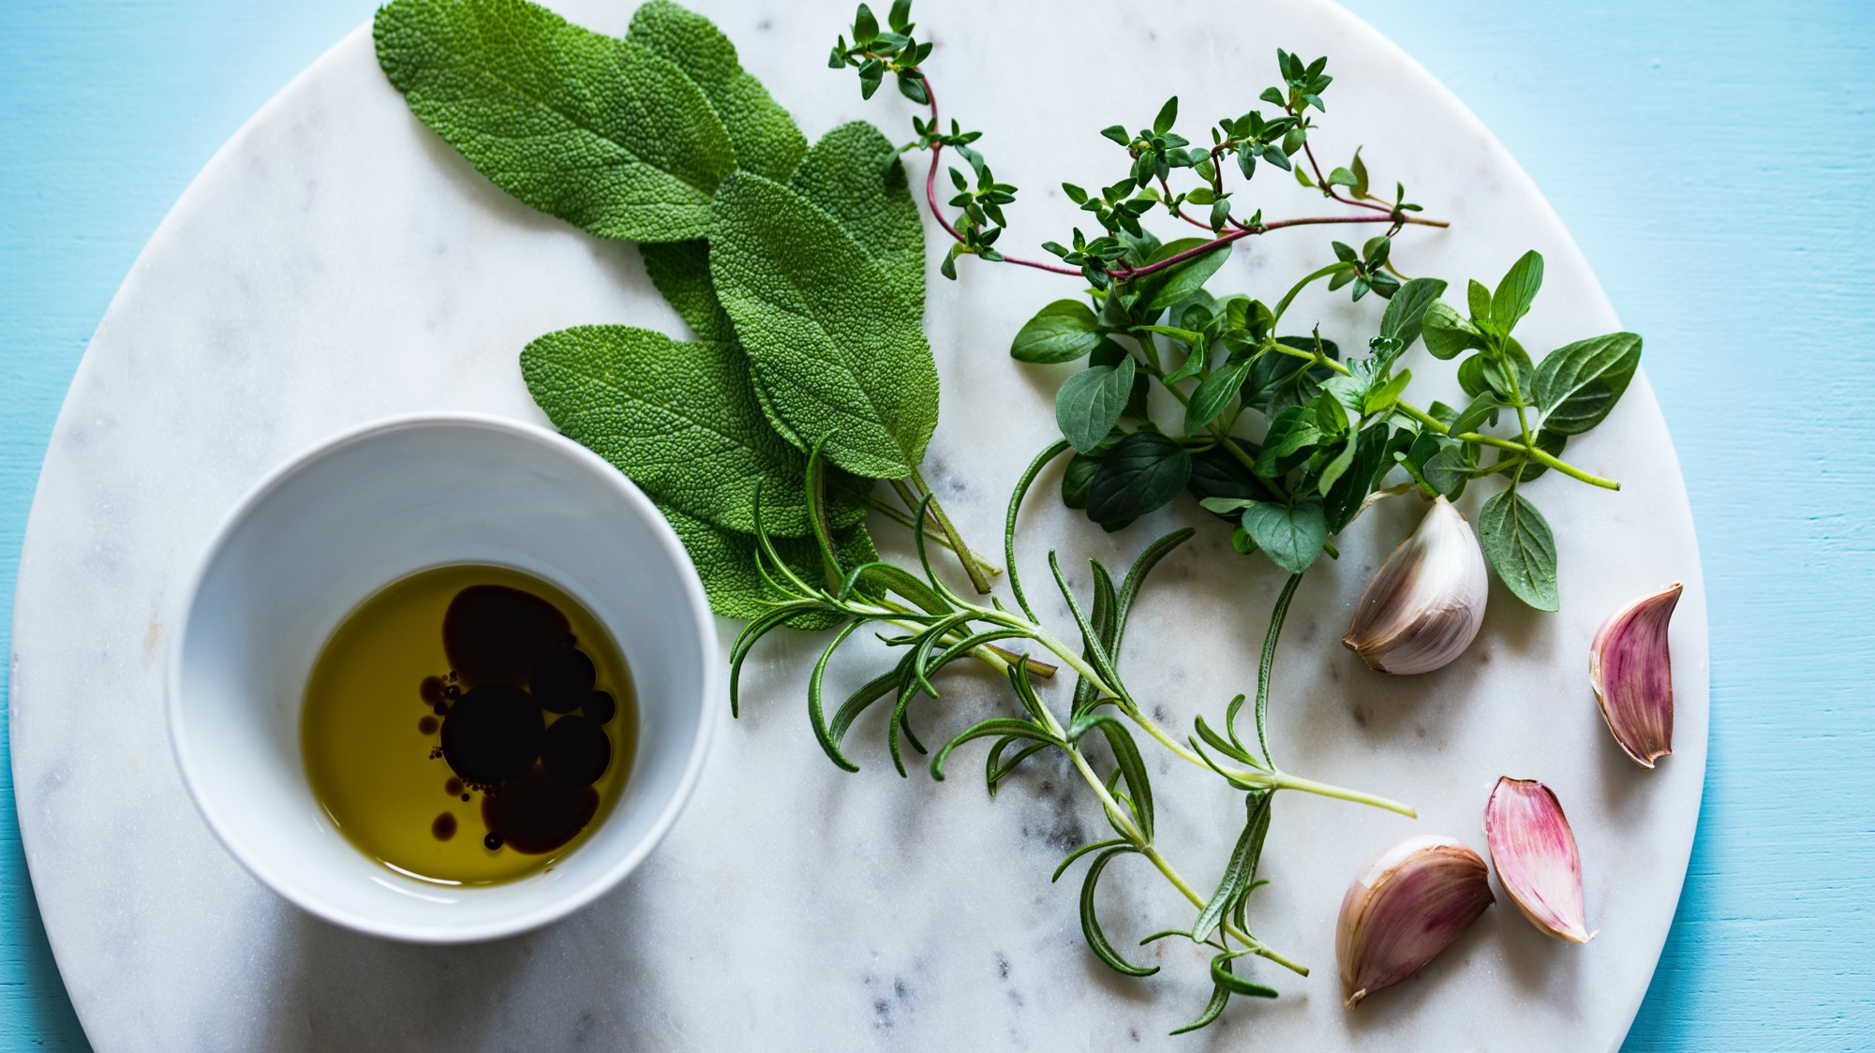
Why are aromas so important?
Notes:
Now we are going to play the silly game!
Now lecturer to give all delegates the sample of the micro tube (DO NOT OPEN YET!), In one hand pinch your nose so you cannot breathe through your nose, make sure to breathe through your mouth. ☺ with the other hand, flip open the tube and pour the contents onto your tongue closing your mouth. Close your mouth, wait a few seconds then release.
You will only experience the taste of cinnamon sugar when you release your nose.

Slide 35

Our sense of smell is responsible for 80% of our flavour experience.
Notes:
Sense of smell
How 80% of smell is responsible for taste. #Aroma #Importance.

Slide 36
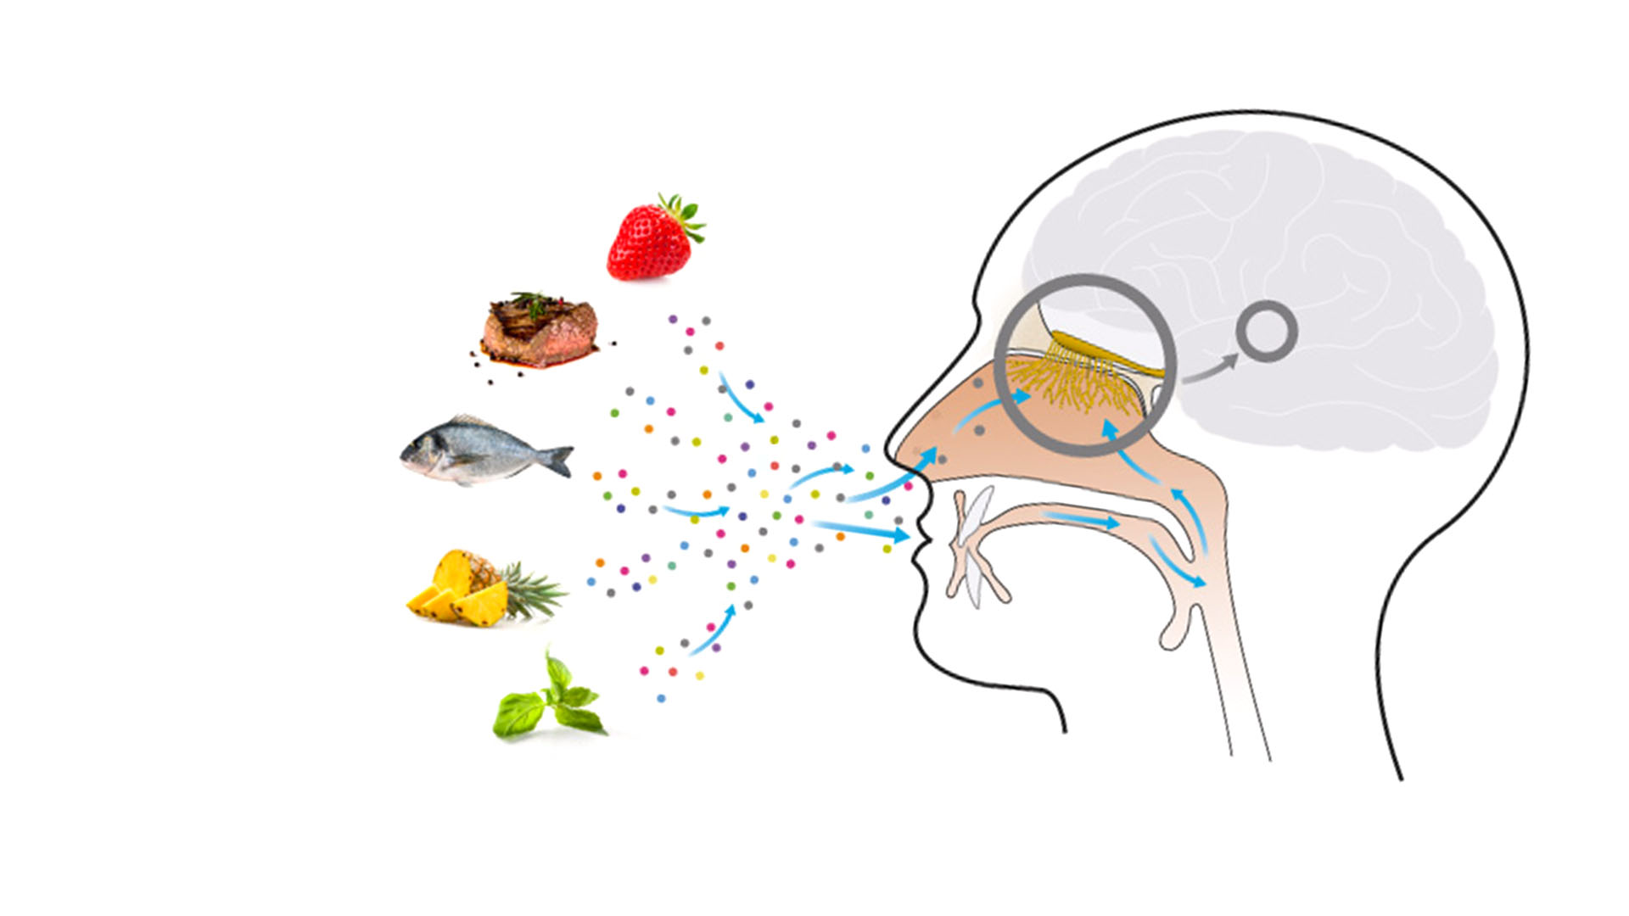
Aromas
Molecules
Volatile
Smell/odour
Nose and
mouth
Notes:
Aromas
Read through the slide information #Aroma = smell/odour, molecules, volatile, nose and mouth.

Slide 37

Primary flavours
Sweet
Sugar
Fruits
Liqueurs
Syrups
Plants
Umami
Soy sauce
Parmesan
Cheese
Salt
Salty
Savour
foods
Oyster
Algae
Sour
Citrus fruits
Yoghurt
Gueuze
Vinegar
Tamarind
Bitter
Grapefruit
Coffee
Tonic
Chocolate
Notes:
The five main tastes
When we talk about taste here, we are referring specifically to the five basic categories of taste that are known and recognized:
SWEET – UMAMI – SALT – SOUR - BITTER

Slide 38

The three dimensions of creating a dish
Balance is key!
#plateflavour
Recipe
Aroma
Texture
Taste
Notes:
Foodpairing
Read through the slide information # Plate Flavour!
Hand icon: Click on the hand icon to go to a Foodpairing blog about the three dimensions of creating a dish.

Slide 39
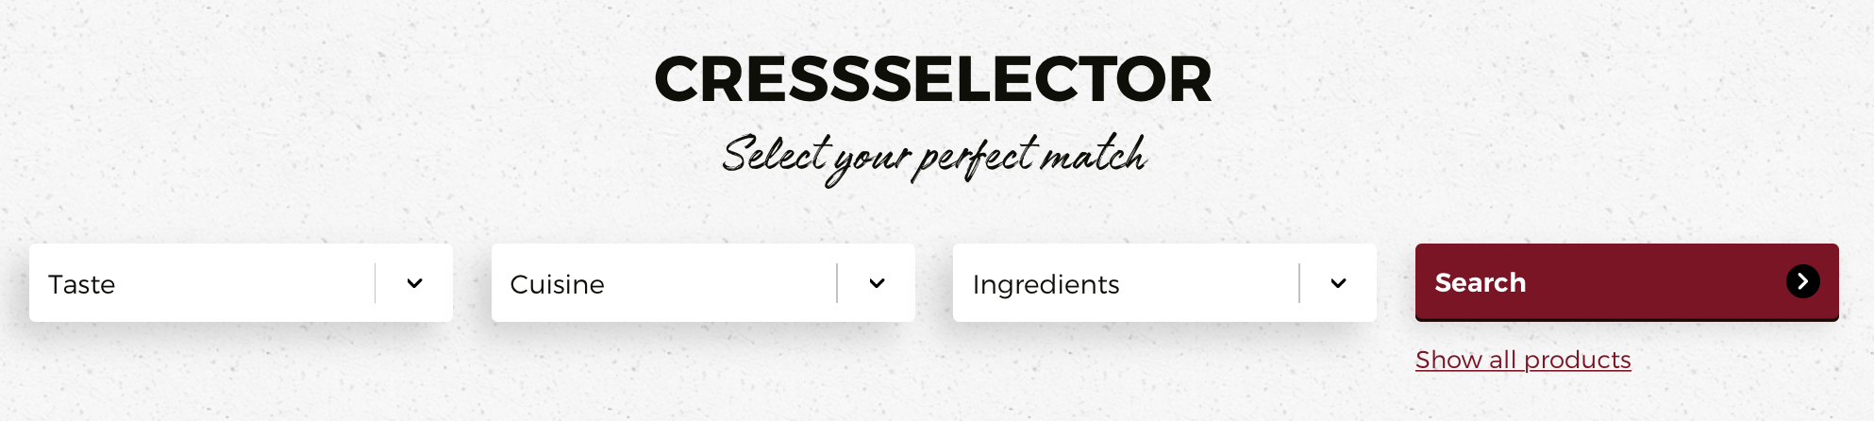
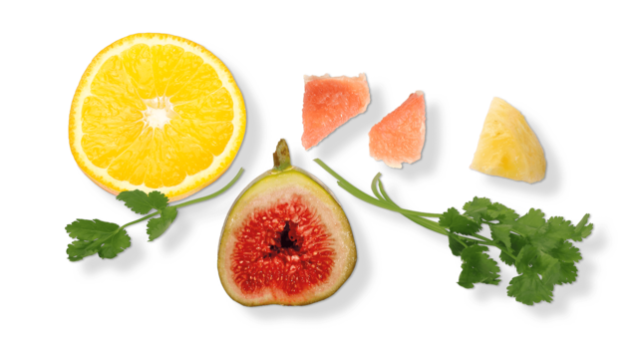
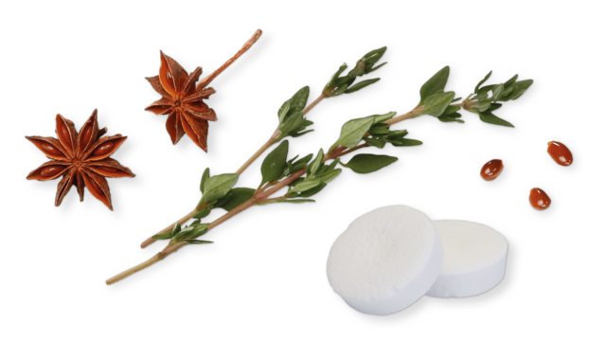
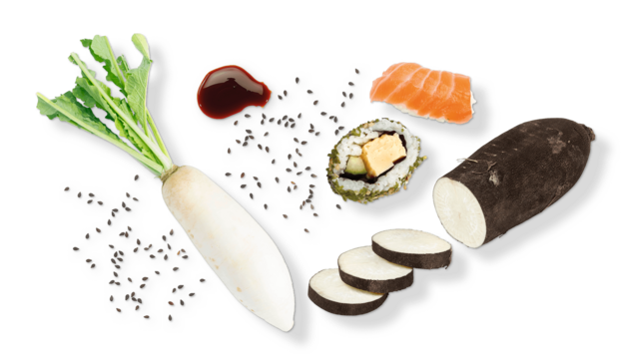
Notes:
‘NEW’ Koppert Cress website
The New Koppert Cress website provides the cressselector, in order to help match Koppert Cress products with components you’d like to use in your recipe.
Hand icon: Click on the hand icon to go to the Koppert Cress website.

Slide 40
Q&A
Notes:
Thank you
We are excited to keep you updated about our journey via our social media channels.

